Slide 1
Bio 211 Dune Lab Redesign
By Nick Heyer, Madison McCarty, Sophia Rose, Zane Toyon
Notes:
MADISON
Intro:
-ongoing collaborative study between CA State Parks Department and CSUMB (1998)
-data is collected in BIO211L primarily from Fort Ord Dunes State Park
-state 3 goals: compile old data into standard format, create new data entry template, extracting and storing new data

Slide 2
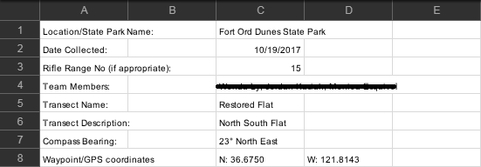
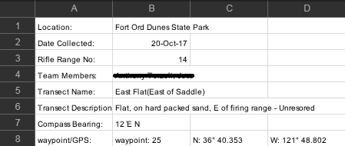
Past Data: The Problem
Notes:
NICK
-Every possible format for every metadata field was used at some point

Slide 3
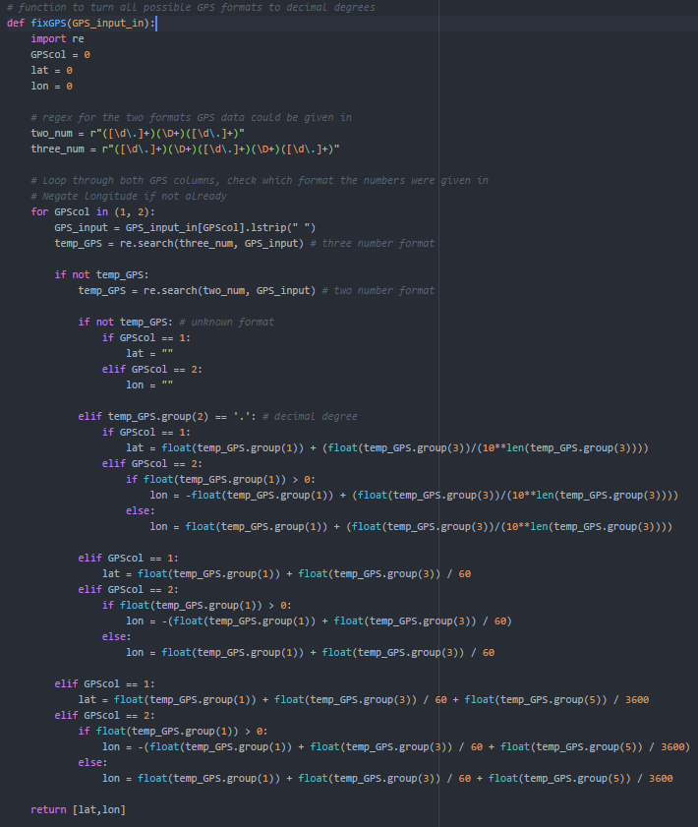
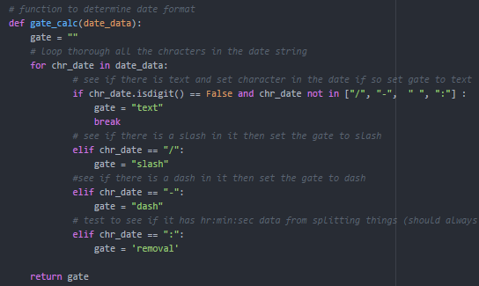
Past Data:
The Solution
Notes:
NICK
-Python script that turns sheets in Excel notebooks into tsvs
-Python script that pulls out the important data and reformats as needed
-Methods that account for every format

Slide 4
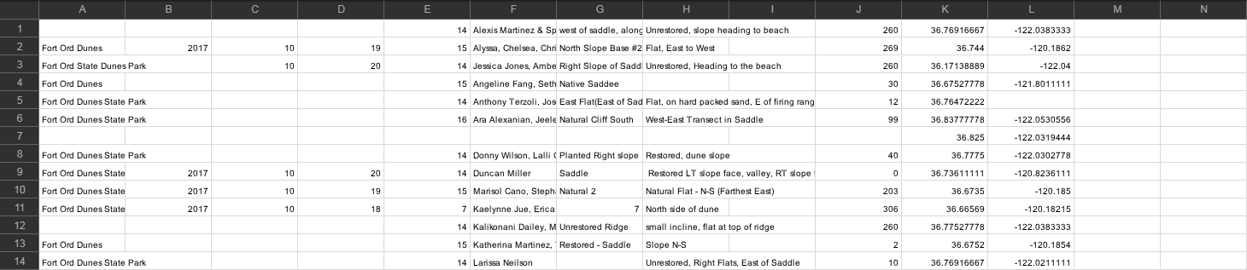
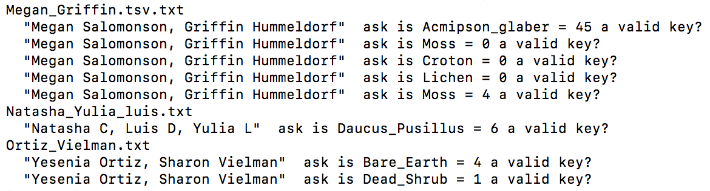
Past Data: The Product
Notes:
NICK
-UNIX script that takes several tsvs and compiles into a master tsv
-Prints errors for cases not handled by our script

Slide 5
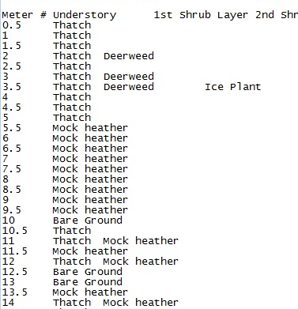
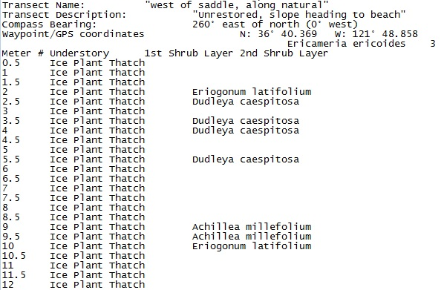
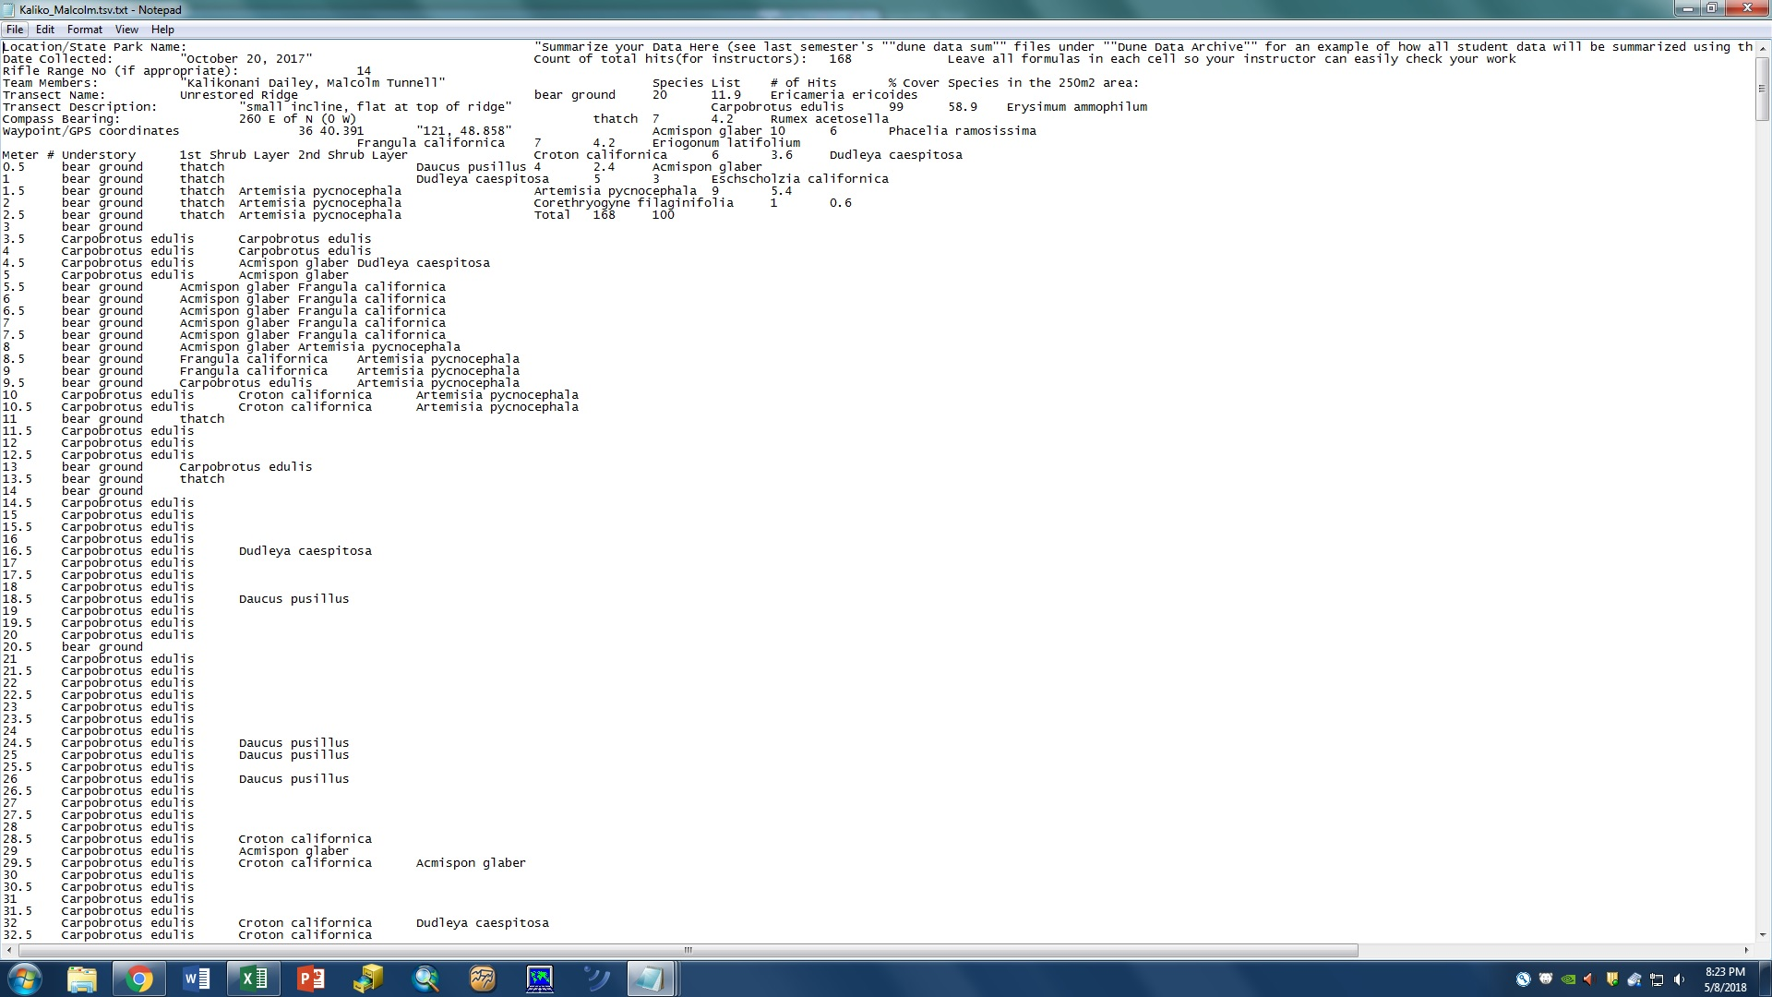
Data Entry: The Problem
Notes:
ZANE
-Misspellings
-Weird formats
-Template editing

Slide 6
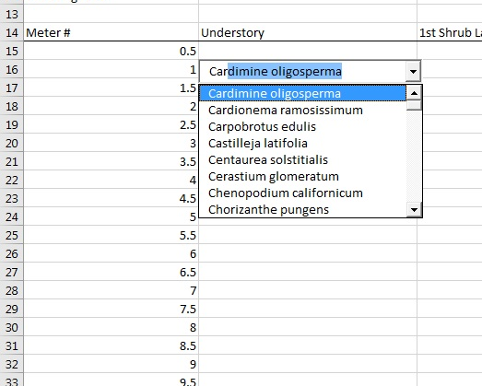
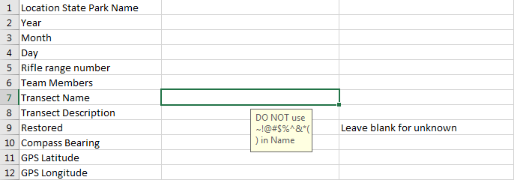
Data Entry: The Solution
Notes:
ZANE
-Autofilling cells
-Drop down menus
-Instructions for cells that can’t be autofilled or use menus
-Locked cells, locked formatting

Slide 7
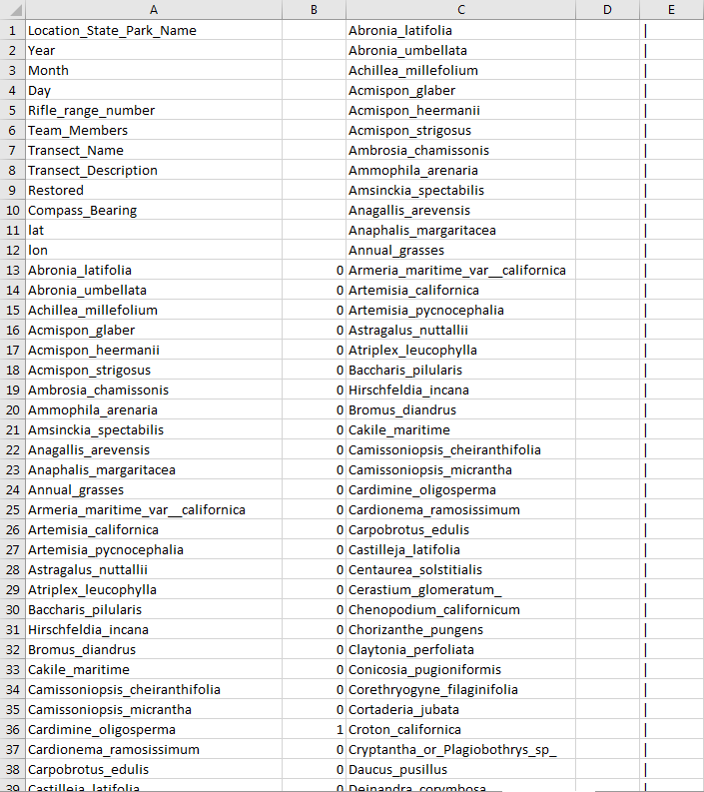
Data Entry: The Product
An Excel Notebook with:
Data Entry sheet
Example Data Entry sheet
Reference sheet
“Sheet4”
Slurp Sheet
Notes:
ZANE

Slide 8
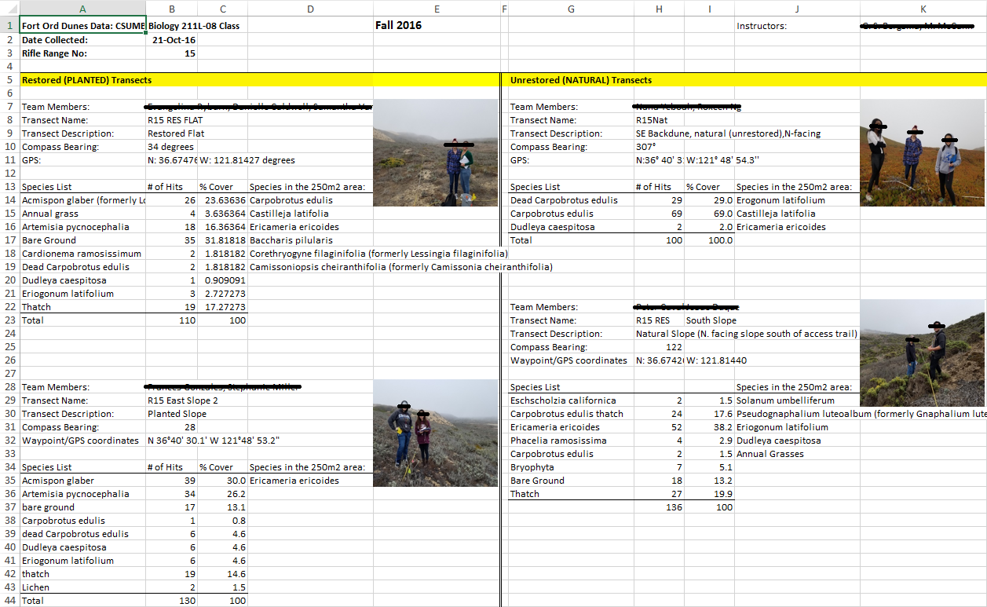
Extracting and Storing New Data:
The Problem
Notes:
SOPHIA
-How the data is given to students
-No other format for the data if it were to be given to other professors or researchers
-Students are expected to sift through notebooks and copy/paste what they want into a new notebook

Slide 9
Extracting and Storing New Data:
The Solution
Pull data out of Slurp Sheet
Order data in the same format as old data
Save to file
Import to database
Notes:
SOPHIA
-Python script that uses the Slurp formatting to create a master tsv in the same manner as the first script
-Created and imported this and old data into a database

Slide 10
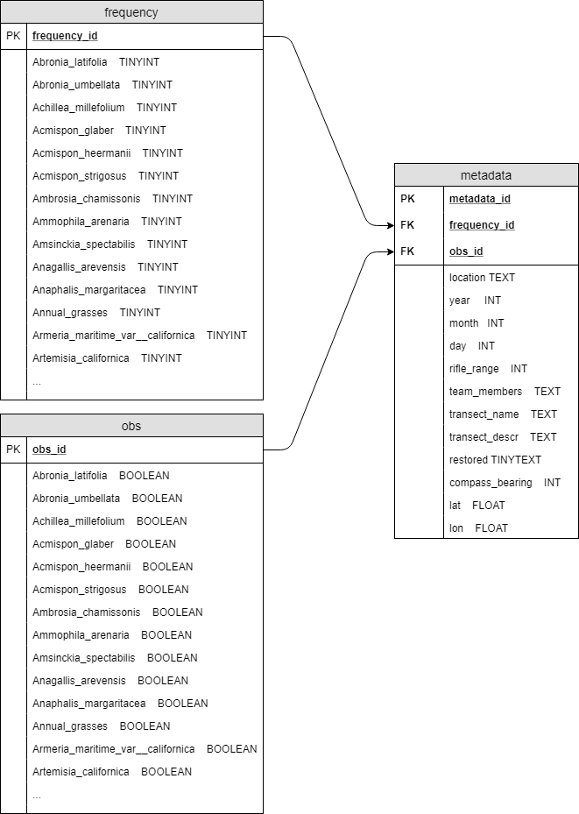
Notes:
SOPHIA

Slide 11
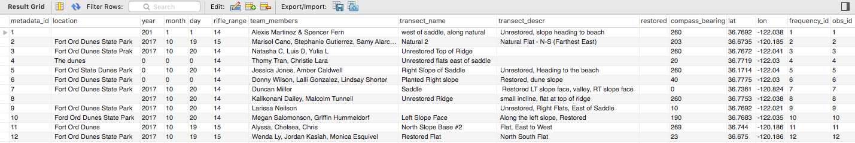
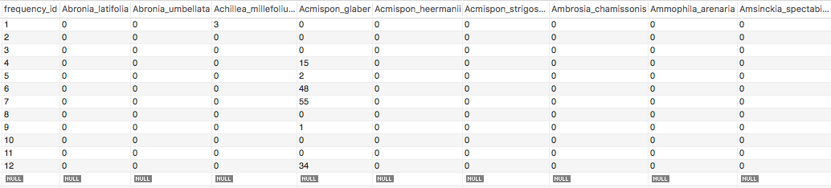
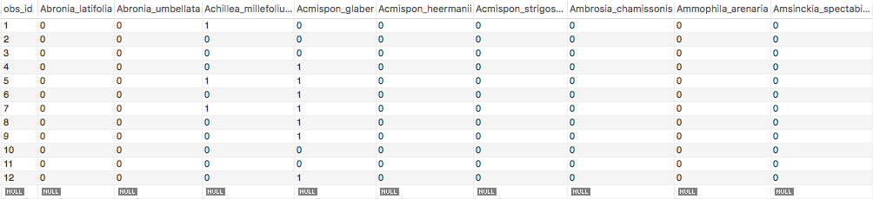
Storing New Data: The Product
Notes:
SOPHIA
-Constructed a database
-Created a SQL script that imports our compiled tsv into the database
-Metadata is the top-most

Slide 12
Future Work
Lab instructor outreach/training
Constructing queries that will output tables useful to Bio 211 students
Database
Transect pictures
Date and Locations as separate tables
Notes:
MADISON

